Slide 1
A.I. Stock Picker
With Machine Learning and Python
Team #12
190330245 K Uday Kiran
190330158 N Pranathi
190330018 A Shivani
190330064 E Sai Srikar

Slide 2
Abstract
With this project we aim to create an investing Artificial Intelligence which could pick stocks for the user based on his/her financial power.
We plan to use core Python, a plethora of machine learning algorithms and libraries.
This is a data-driven approach to the world of stock markets, where one gets to choose how aggressive or defensive one wants to be when investing, without having to worry about losses while celebrating profit gains.
We choose to devise value investing which has been proven to work over time, notably by prominent investors like Warren Buffett and Charlie Munger.

Slide 3
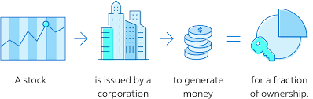
What are Stocks?
Although being a part-owner doesn’t mean one can directly run the place; one cannot enter an office and tell people to do things if one has a bit of a company’ stock.
The company is supervised for the shareholders by a board of directors, who work for you in managing the business.
Once a year the shareholders get to vote on who goes on the board and sometimes vote on a meaningful company event like a big acquisition.
One’s vote is proportional to the number of stocks one holds.
The trading activity for shares is just an auction. Taking part is easy, most banks have a stockbroking platform, and some phone apps
A Stock is a share, a part of a whole.
Stocks have value because they confer to the holder ownership in pieces of a company.

Slide 4
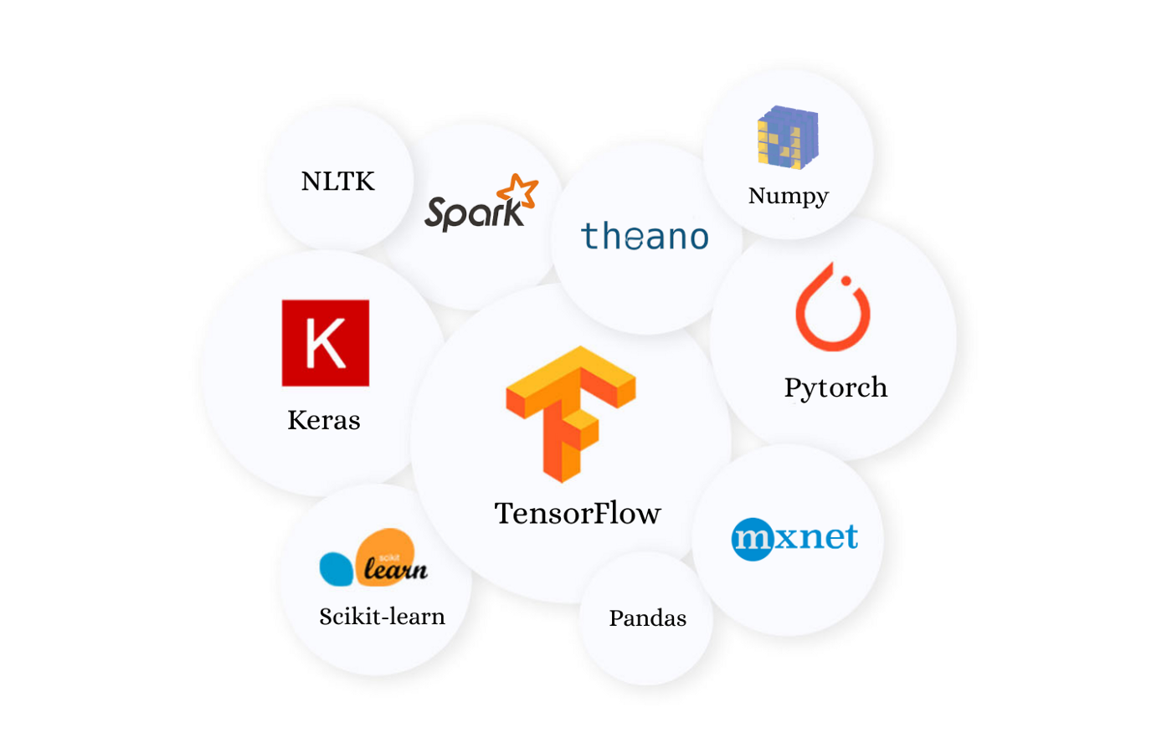
Pre-Requisites and Necessary Libraries
Machine Learning, Python, Jupyter Notebook, Scikit-Learn
In order to deploy the above mentioned technologies installation of the following libraries in python are necessary:
Keras
Numpy
Pandas
SciPy
CV2
Matplotlib
And more…

Slide 5
REQUIREMENTS
Hardware Requirements
Software Requirements
RAM: 12 GB
Processor: Intel® Core™ i7 8550U CPU @ 1.80GHz
Hard Disk: 1 TB
Monitor: 15.6” Color Monitor
Keyboard: 122 Keys
Operating System: Windows 10
Platforms: Jupyter Notebook, Google Colab
Languages: Python

Slide 6
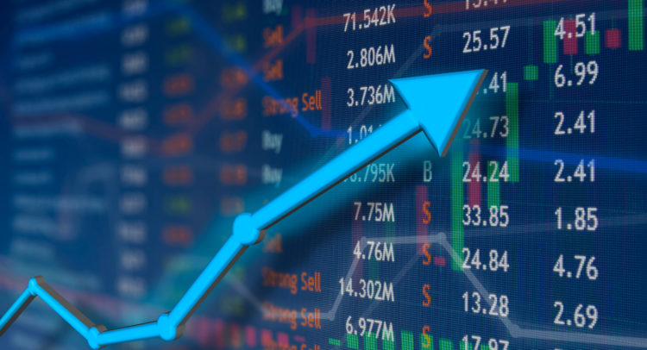
OUTCOME
The outcome of the project was to create a machine learning model.
The model will predict 5-10 stocks that the user can invest over the coming year.
The aim is to have these 5-10 stocks outperform a major index, like the S&P 500, QQQ, etc.

Slide 7

Our Work
GOALS ACHIEVED
Obtain Financial Data and Stock Performance Data
Use the algorithms we have to see if we have any predictive power between financial data ‘now’ and the stock performance ‘a year from now’.
If the models are found to have predictive power, we will use the models, we will use the models to create value investing AIs.
Backtest the investing methods with our historical data to identify the best performing algorithms.
Picked the winner and tweaked it further for performance improvements.

Slide 8
